Slide 1
WEEK 3
Part B: TABLES

Slide 2
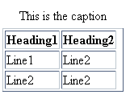
TABLES
The ability to lay out any page content into rows and columns
Caption or what the table is about.
Head for columns or rows
Table data
Line1
Table cells

Slide 3
<TABLE>
<caption>An optional heading</caption>
<th>Heading</th>
<tr>Indicates a row</tr>
<td>Table data</td>

Slide 4
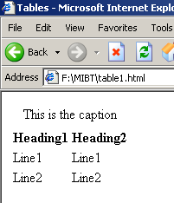
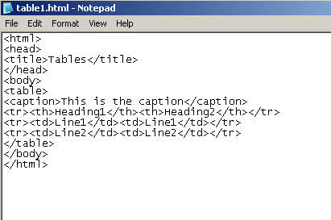

Slide 5
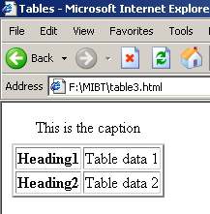
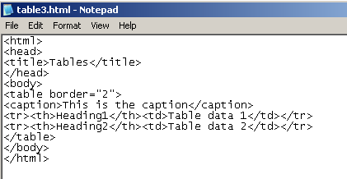

Slide 6
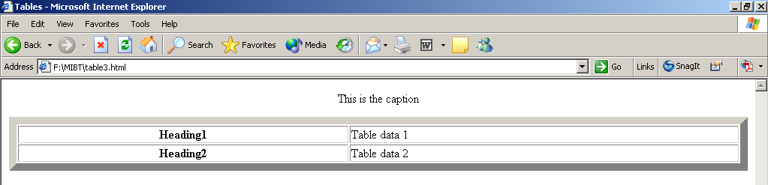
<table border=”10" width="100%">

Slide 7
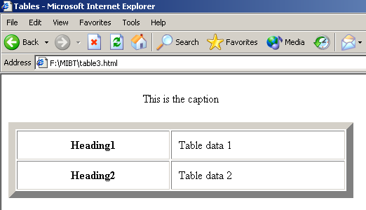
<table border=”10" width=”50%” cellpadding=“10”>

Slide 8
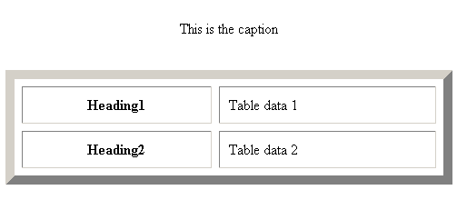
<table border=”10" width=”50%” cellpadding=“10” cellspacing=“8”>

Slide 9
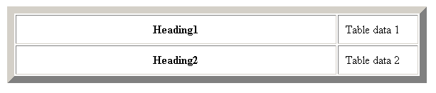
<table border="10" width="60%" cellpadding="10">
<tr><th width="80%">Heading1</th><td width="20%">Table data 1</td></tr>
<tr><th width="80%">Heading2</th><td width="20%">Table data 2</td></tr>
</table>

Slide 10
<table bgcolor="aqua" border="10”
bordercolordark="red"
bordercolorlight="yellow" "width="60%”
cellpadding="10"
cellspacing="8">
bordercolor=“” overrides the 3D border effect – only works in IE
<tr bgcolor=“#000000”>
You can change the color of just one row or just one cell.
<td bgcolor=“#000000”>

Slide 11
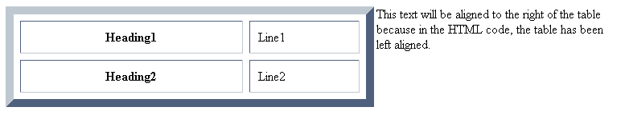
<table border="10" width="60%" align="left"
cellpadding="10" cellspacing="8">

Slide 12
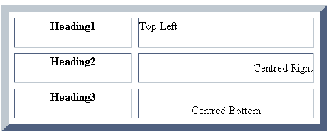
<tr><th>heading1<p></th><td align="left"
valign="top">top left</td></tr>
<tr><th>heading2<p></th><td align="right”
valign="middle">centred right</td>
<tr><th>heading3<p></th><td align="center"
valign="bottom">centred bottom</td>

Slide 13
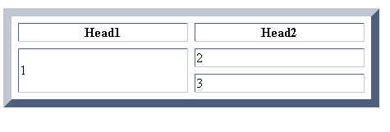
<tr><th>head1</th><th>head2</th>
<tr><td rowspan="2">1</td><td>2</td></tr>
<tr><td>3</td></tr>

Slide 14
<tr><th colspan=“2”>a heading</th></tr>
<tr><td>1</td><td>2</td></tr>
<tr><td>3</td><td>4</td></tr>

Slide 15
CONTENTS
A table cell can include text or images or html code.
If a cell is to be blank, something must be put into it, for example, include a <br /> tag.

Slide 16
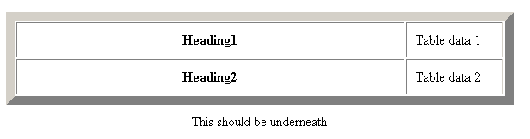
CAPTIONS
If you want to change the position of the caption –
<caption align=“bottom”>

Slide 17
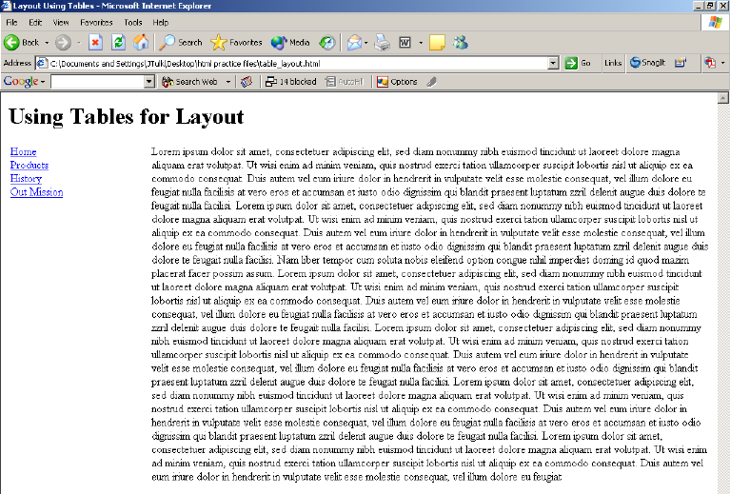
SAMPLE TABLE FOR PAGE LAYOUT
Special features, 1st column:
<td width=“20%” valign=“top”>

Slide 18
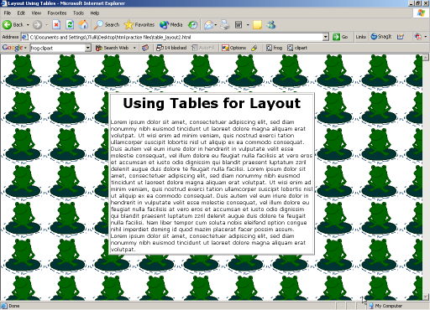
Special features:
<table width="50%" align="center" bgcolor="#ffffff" border="2">

